Slide 1
TOLL TAX SYSTEM PROTOTYPE
DEEPIKA SG(210701048)
GOPIKA KV(210701063) HAARTHY SL(210701065)

Slide 2
ABSTRACT
This project presents the development of an automated Toll Tax System using an Arduino microcontroller, integrated with an ultrasonic sensor and a servo motor. The system is designed to efficiently manage toll collection by automatically detecting vehicles and controlling the barrier for entry and exit. The ultrasonic sensor measures the distance to approaching vehicles, triggering the servo motor to raise the barrier when a vehicle is within a specified range. This setup reduces the need for human intervention, minimizes traffic congestion, and ensures seamless toll operations. The automated toll tax system is a cost-effective and scalable solution, suitable for implementation in various toll booths.

Slide 3

Project objective
To develop a prototype of the toll gate system and also to understand its working procedure so to implement this idea in many other domains which can help as a basis of many other projects.
Whenever the sensor senses any upcoming object in its sensing range the micro servo is made to lift up to 90 degrees for the vehicle to pass on or otherwise the gate aka the micro servo fan stays at ground 0 degree.

Slide 4
Components Required
ARDUINO UNO R3 BOARD
ULTRASONIC HC-SR04 SENSOR
JUMPER WIRES (male to male,female to male)
MICRO SERVO SG90g
BREADBOARD
LAPTOP WITH ARDUINO IDE LATEST VERS. DOWNLOADED
USB PROBE TO CONNECT LAPTOP AND ARDUINO
LED or BUZZER

Slide 5
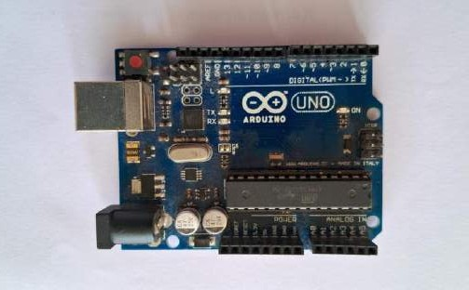
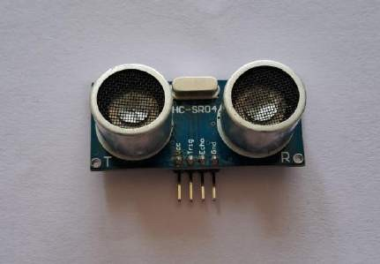
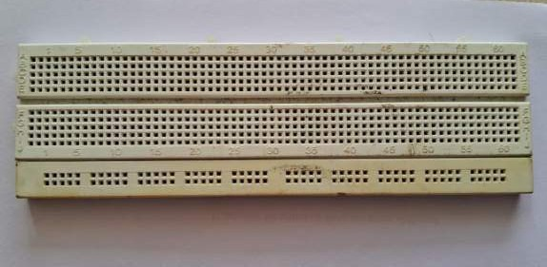

Slide 6
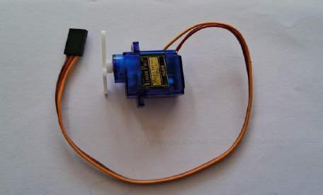
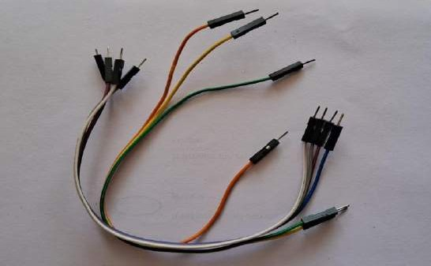
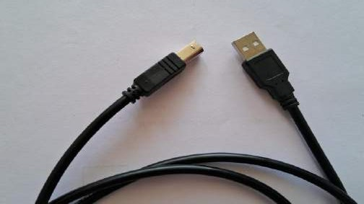

Slide 7
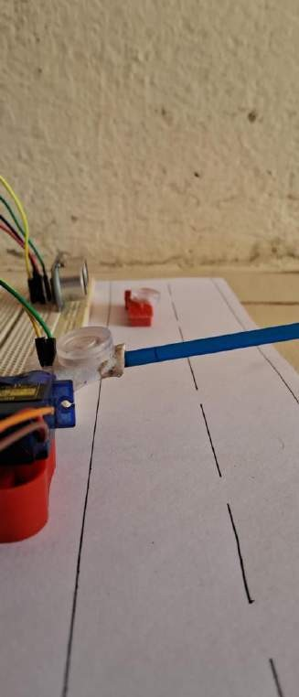
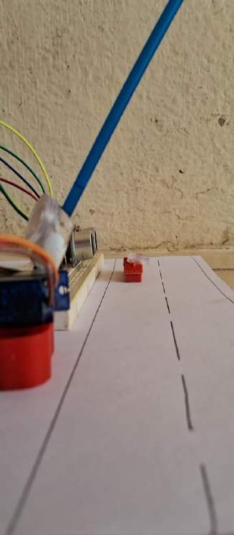
WORKING
In this project, we are making an exact replica found in toll plaza centers that is called as stopping system, The idea for this project was inspired from actual system, in actual toll they stop the vehicles using a stopper that is completely automated and it is activated when any vehicle passes in front the sensor, or some time it’s activated through a button.

Slide 8
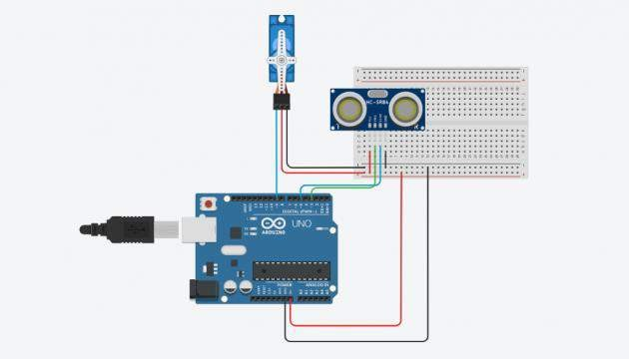
CIRCUIT DIAGRAM FOR THE TOLL TAX SYSTEM
Connections:

Slide 9
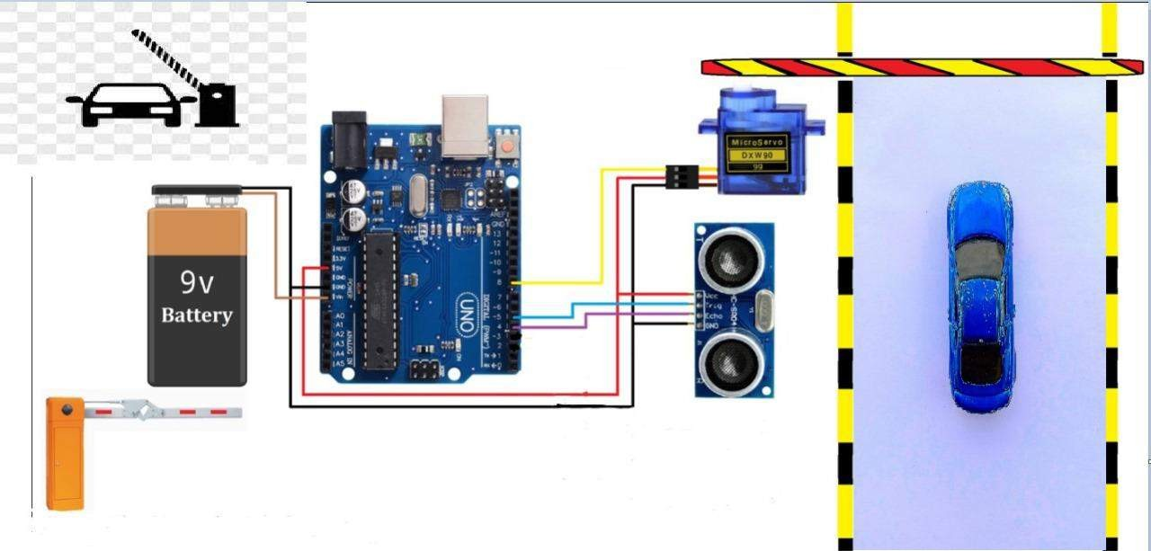
When implemented in toll system aka
when car arrives in front of sensor

Slide 10
HOW DO IT WORK?
The connections are done as shown in the circuit and the micro servo is connected to the 9th pin in the arduino where the arduino is loaded with the right code then the control of micro servo whenever receives signal from sensor HC-SR04 the arduino makes the control of micro servo rise to 90 degrees above making way for the vehicle in our case as toll tax system.

Slide 11
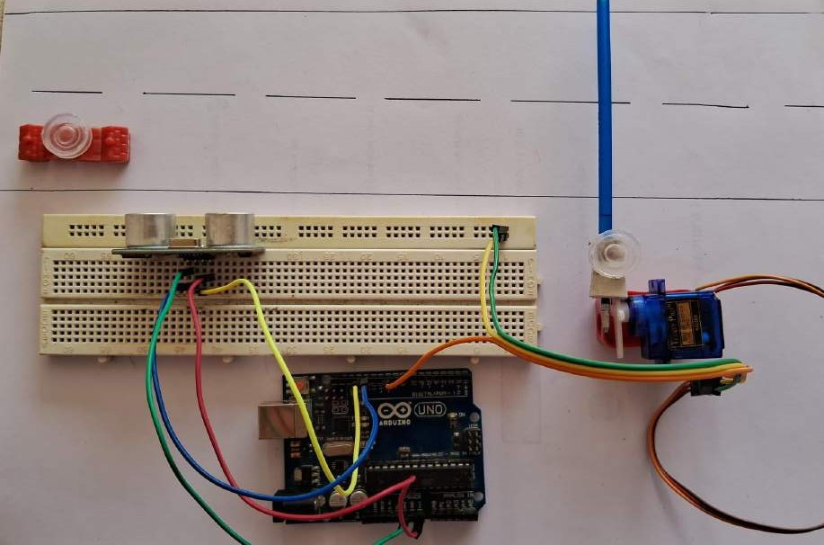
OUR PROJECT IMPLEMENTATION

Slide 12
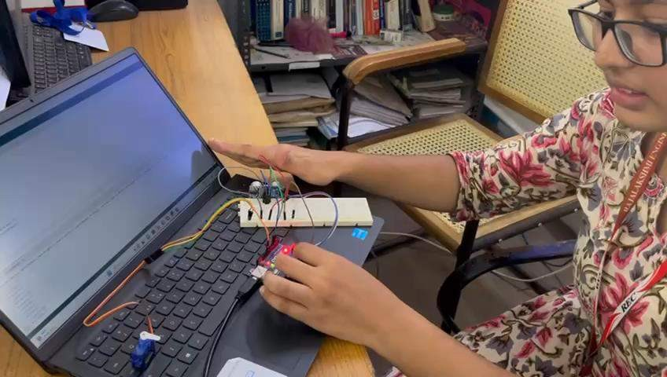
WORKING DEMO
The micro servo turns 90 degree is what our team member is trying to explain in the beginning of the video and also how the fan turns when the hand of our team member is sensed by the sensor is what we have tried to explain here.

Slide 13
FUTURE SCOPE AND CONCLUSION
This prototype has become a equipment in many of the domains and many yet to come, the manufacturing companies when their product has to be pushed into boxes when arrives from prior machine, the door opening system in shops,malls etc, the garbage dumping system with upgradation of blue-white-green waste can all use this as the basis thus is important to understand it working.
The implementation of an IoT-based toll tax system represents a significant advancement in the management and efficiency of toll collection processes.This system leverages modern technology to address many of the challenges faced by traditional toll collection methods.

Slide 14
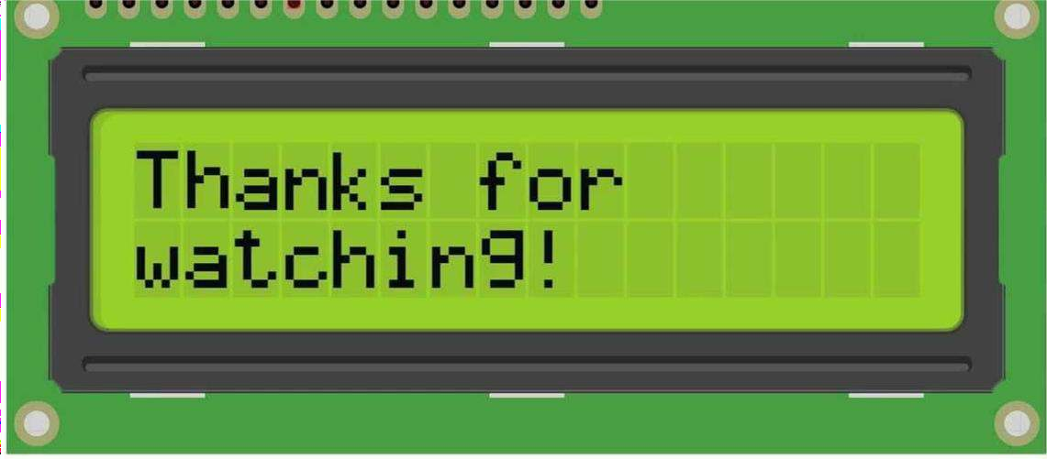
THE END!

